Slide 1

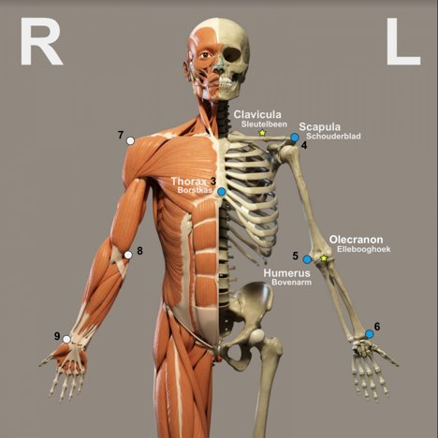

Ortho Eyes
Dr. Tony Andrioli​
Raphael, Brice, Eddie, Hassan, Arjun, Lennart, Rachelle
Notes:
Raphi

Slide 2
General plan
Until week 8
Data visualization.
Week 8-18
Research on new techniques to categorize the patient groups.
Find out new parameters
Write a research paper.
Reproducing work from last group.
Develop our skills in machine learning.
2
1/11/2020
Notes:
Raphi

Slide 3

This sprint
Issues:
Enrich the data
Detect anomalies in our data
3
1/11/2020

Slide 4
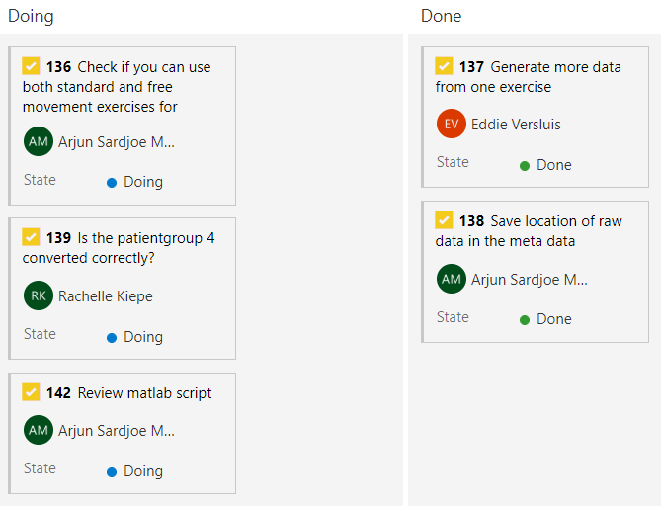
Enrich our data for machine learning
4
1/11/2020

Slide 5
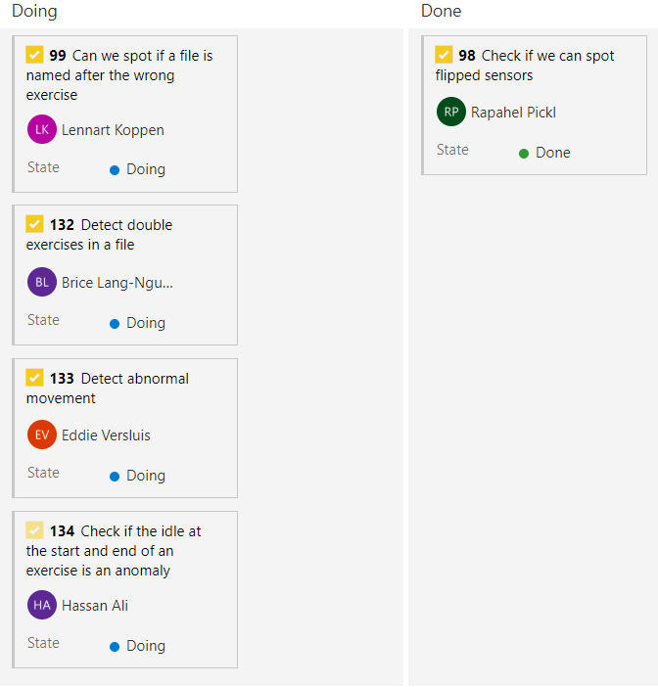
Detect anomalies in our Data
5
1/11/2020

Slide 6
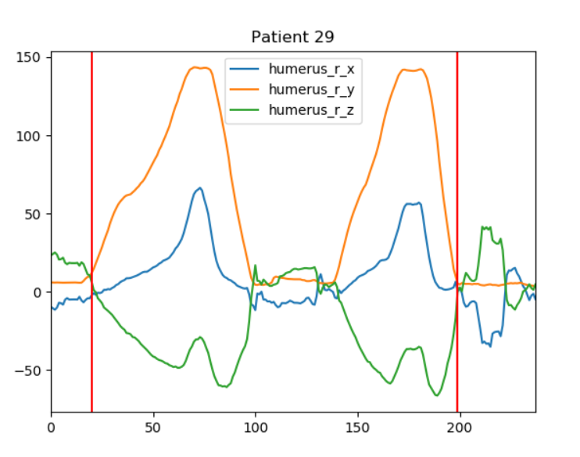
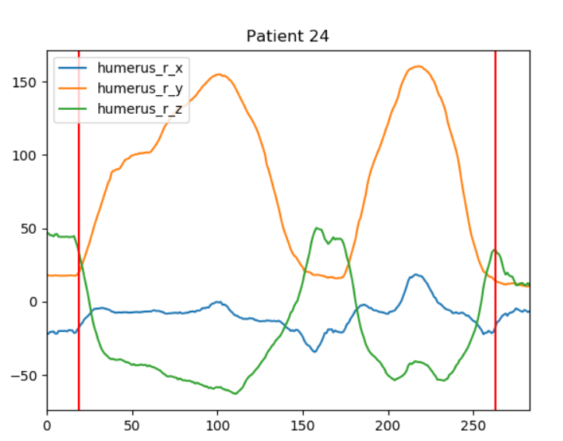
noise at the start and end of an exercise
6
1/11/2020

Slide 7
Plot using the raw data
7
1/11/2020

Slide 8
Plot using the raw data
8
1/11/2020

Slide 9
What is next
Finish the tasks for this sprint
Start with data cleaning and getting rid of the anomalies
Normalizing the data
Resample the data to the same size
9
1/11/2020

Slide 10
Questions & Suggestions
?
10
1/11/2020

